Slide 1
BRIGHT TV VIEWERSHIP ANALYTICS
Presenter: Ndivhuwo Netshiendeulu
Date 19 April 2026

Slide 2
Contents
Introduction
Data Systems
Analysis
Recommendations
Q&A

Slide 3
Introduction
Bright TV is a media company where TV viewers subscribe to view different channel contents.
The CEO wants to grow the company’s subscription base for this financial year.
I am tasked to analyse 4 months historical data consisting of user profiles and viewership, in-order to understand Bright TV’s viewership trends.
Aim
The aim of this project is to extract insights from the data and provide support to the Customer Value Management (CVM) team.

Slide 4
Data Systems
Project Planning
-Miro for project planning (analysis process planning and process flow diagram)
-Canva for project planning (project timeline on Gantt Chart)
Data Processing
-Databricks (SQL)
Data Visualisation
-Microsoft Excel for Data Visualisation and Dashboard creation
-Google Looker Studio for Dashboard creation
-Microsoft Power BI for Dashboard creation
-Lovable AI for Dashboard creation
Presentation
-Microsoft PowerPoint
-NotebookLM AI for presentation

Slide 5
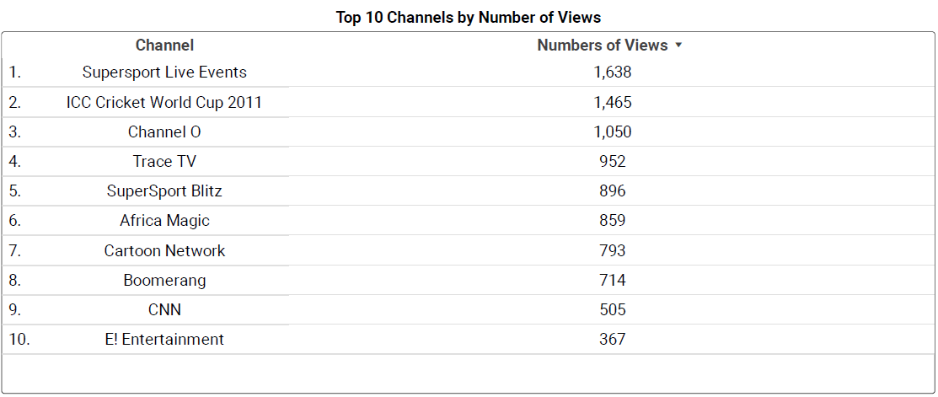
Analysis
Total viewers: 10 000
Total Channels: 21
Insights
The total number of TV views is 10000 over the 4 months period.
There are 21 TV channels.
The most viewed channels are sports (Supersport Live Events with 1637 views) and ICC Cricket World Cup 2011 with 1464 views), followed by music (Channel O with 1050 views).

Slide 6
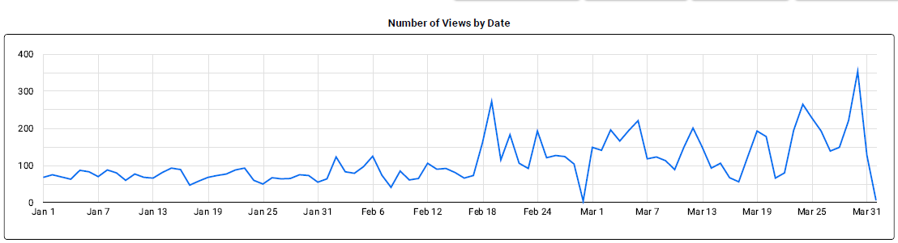
Analysis
Insights
There is an upward trend in the number of views from January (2199) which peaks in March (4816).
Friday (1675) is the highest consumption day of the week, followed by Saturday (1633) and Wednesday (1553).
Monday (957) is the lowest consumption day of the week.
Afternoon (3734) is the most popular time to view TV , followed by the evening (2482), while night (1329) is the least popular time to view TV.

Slide 7
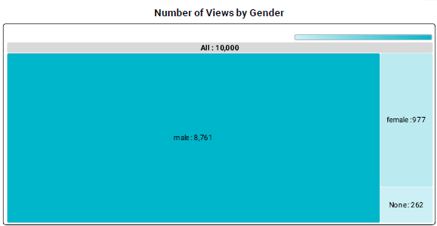
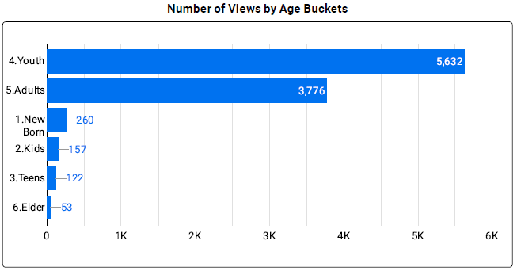
Analysis
Insights
The male gender has the highest views (8755), while female have low views (977).
It is hard to classify the None gender category because they did not provide enough information.
The Youth (5632) have the largest number of TV views, followed by adults (3776), while elders (53) are the lowest number of TV viewers.

Slide 8
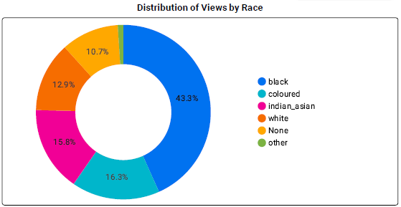
Analysis
Insights
The Black Race (43.3%) is the majority TV viewer, followed by Coloured (16.3%) and Indian_Asian (15.8%), while the White Race has a low (12.9%) viewership
The None category did not provide information about their Race, so it is not possible to classify them
While the Other Race category maybe they do not fall within the specified categories

Slide 9
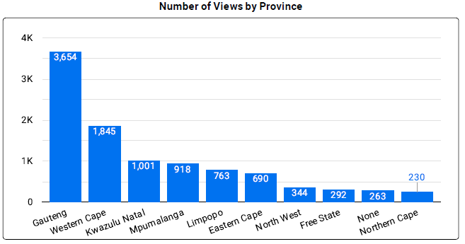
Analysis
Insights
Gauteng has the largest number of TV views (3654), followed by Western Cape (1845), and KwaZulu Natal (1001).
Free State (292) and Northern Cape (230) have lower number of views.
The None category did not specify their exact province location

Slide 10
Recommendations
Show content with high number of viewers such as: Supersport Live Events, ICC Cricket World Cup 2011, Channel 0 and Trace TV, to attract more youth and teen viewers on days with low TV consumption (e.g. Monday), to increase viewership.
Grow the number of female viewers by showing content that appeals to females e.g. E!Entertainment and African Magic.
Focus on growing viewership in provinces like the Northern Cape and Free State through location specific promotions.
Show more shows that can attract white viewers, maybe Afrikaans language content.
In the afternoon focus on kids friendly content such as Cartoon Network and Boomerang, to increase the number of kids viewers.
Do not neglect your most loyal viewers including provinces with high views, the youth and adults, the black race and Friday- the highest TV consumption day.

Slide 11
Q & A

